Slide 1

#LifeKoKaroLift
MLOps

Slide 2



Course : Machine Learning
Lecture On : MLOPs Architecture
Instructor : Aditya Bhattacharya

Slide 3
Today’s Agenda
1
Recalling the concepts taught earlier
2
Explain the MLOps stack in detail
3
Different Roles in MLOps
4
Doubt Resolution

Slide 4
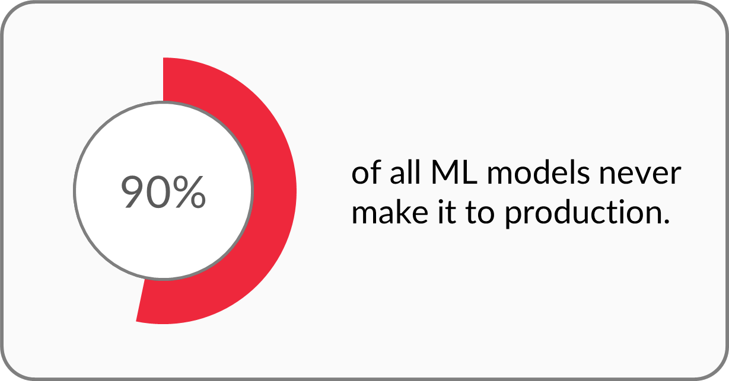
What is the state of ML solution in production?

Slide 5

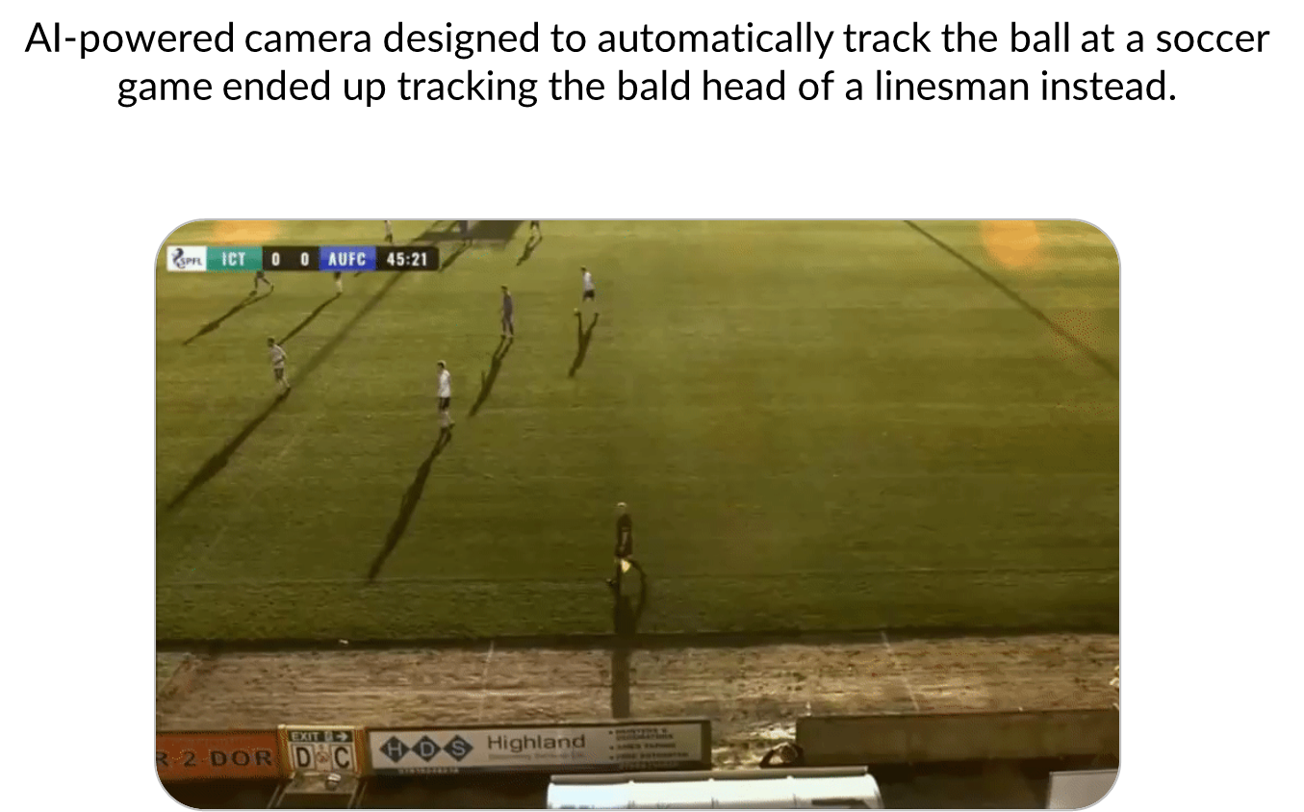
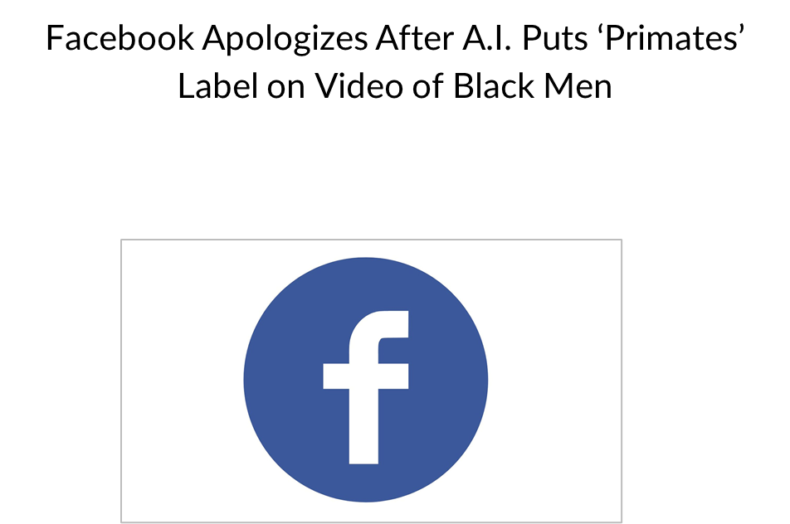
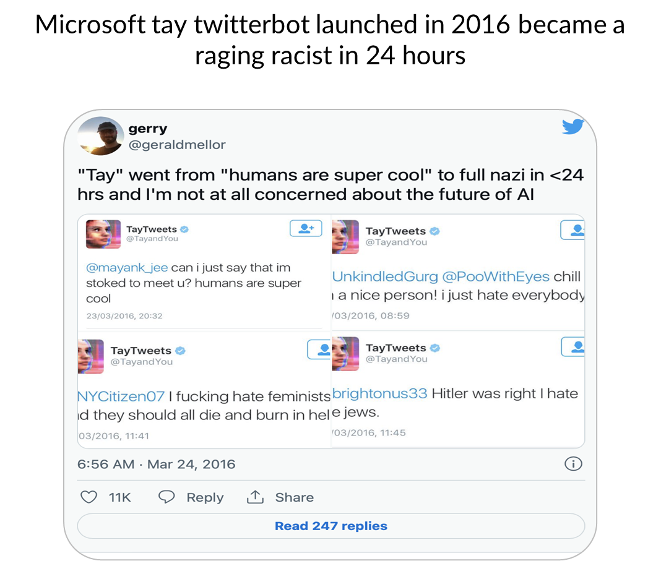

Is moving ML models to production enough?

Slide 6
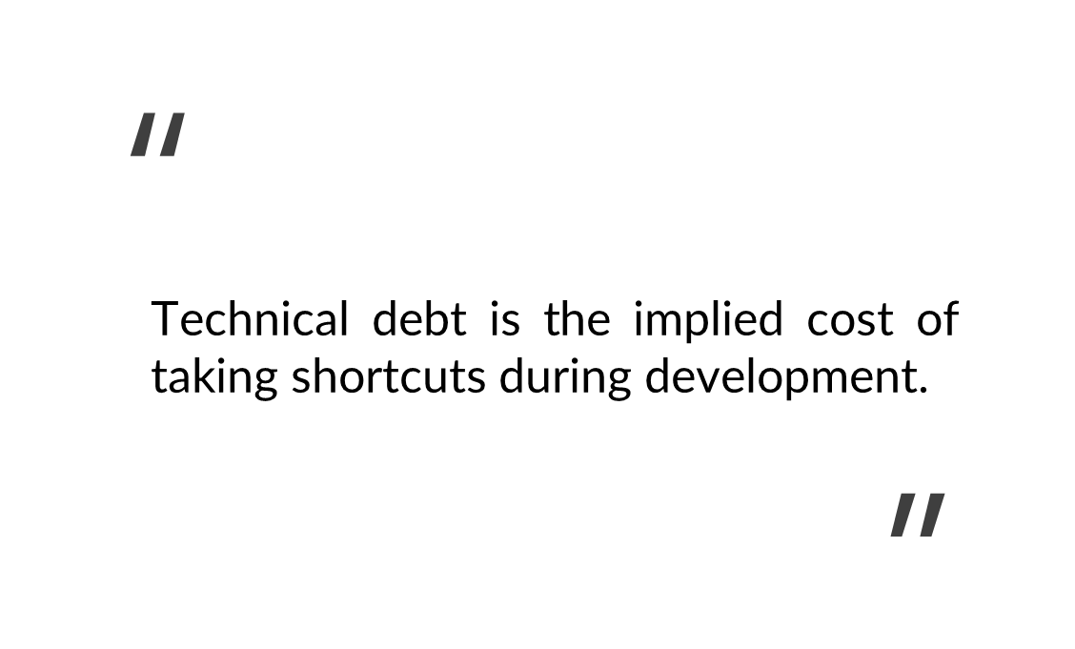

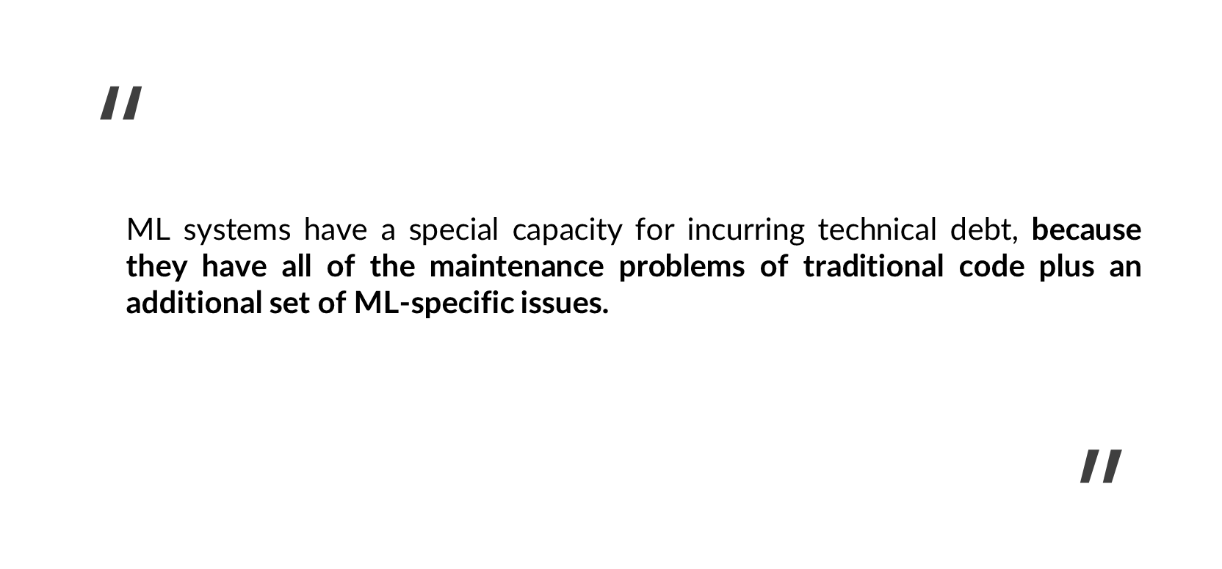
Technical Debt in ML

Slide 7
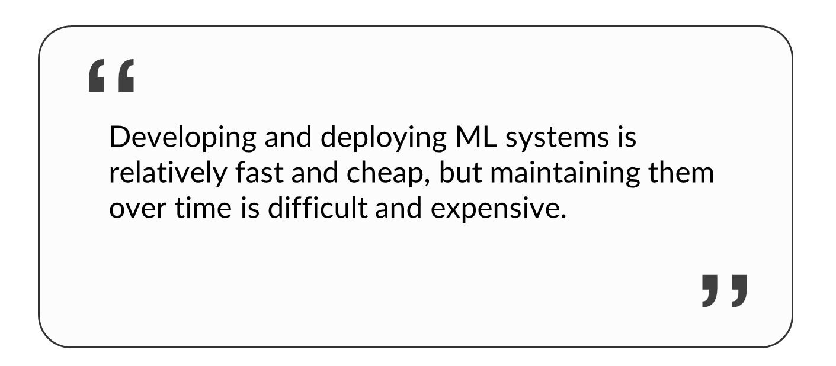

Slide 8
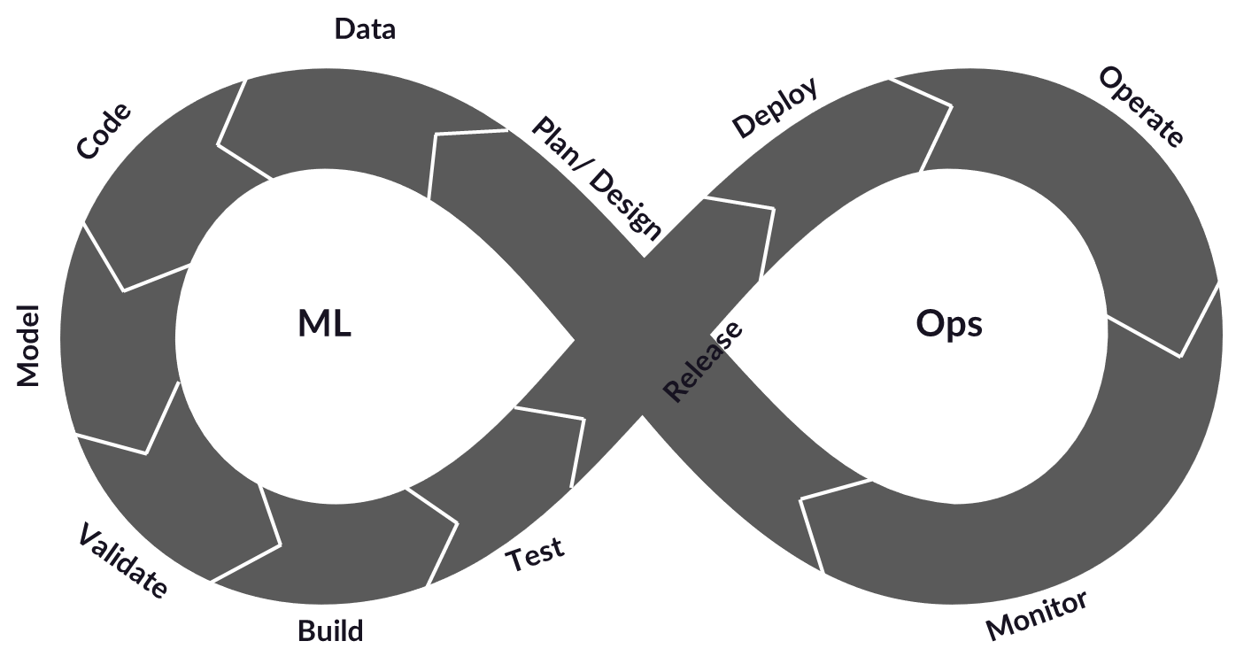
DATA + MODEL + DEVOPS = MLOPS

Slide 9
MLOps as a practice
Shorter development cycles and as a result, shorter time to market.
Increased reliability, performance, scalability and security of ML systems.
Increased return on investment of ML projects due to reduced maintenance overhead.
Better collaboration among teams.
Streamlined operational and governance processes.

Slide 10
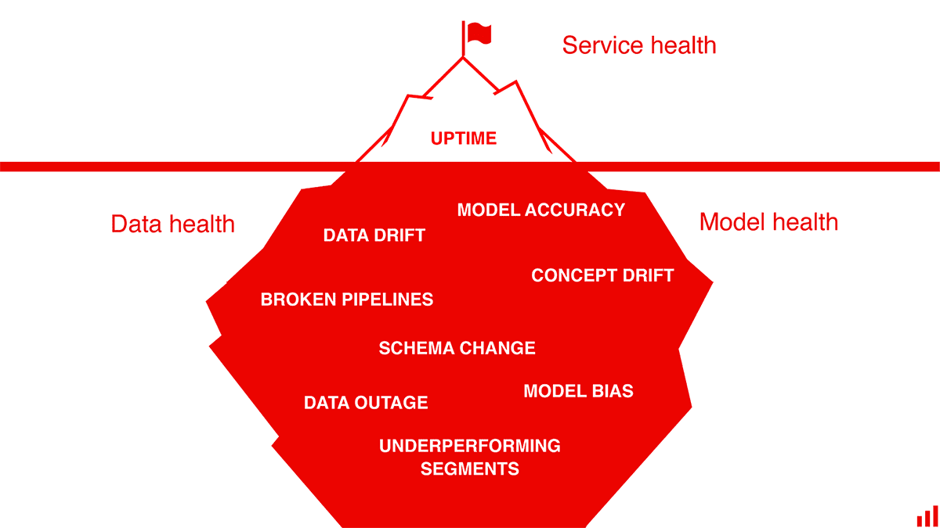
MLOps System Design Process

Slide 11
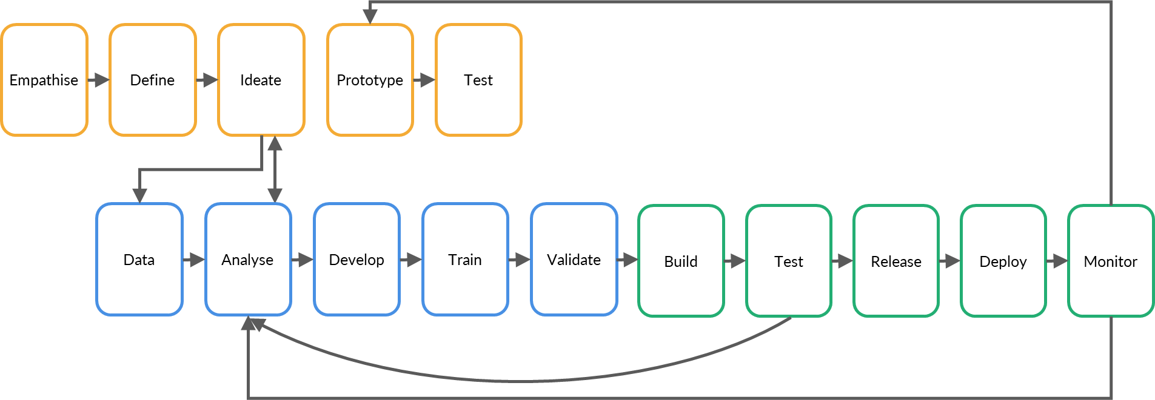
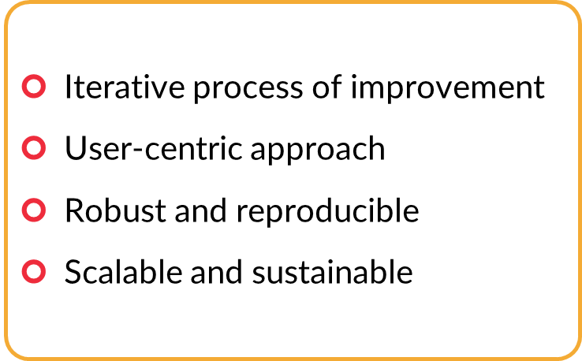
MLOps System Design Process

Slide 12
MLOps Architecture Stack

Slide 13
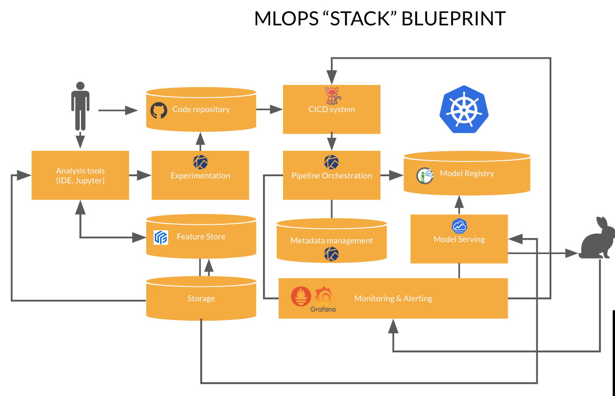
MLOps Architecture Stack

Slide 14


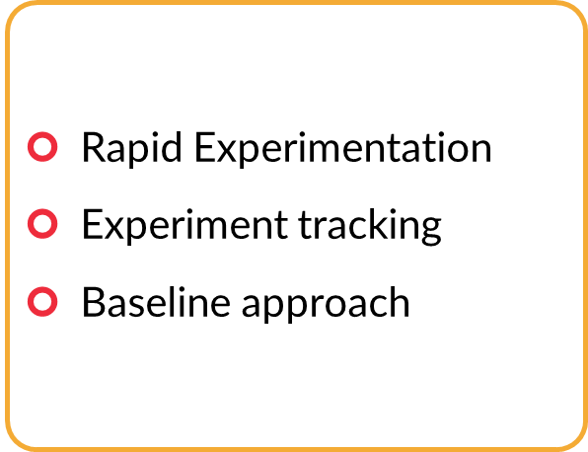






ML Development

Slide 15
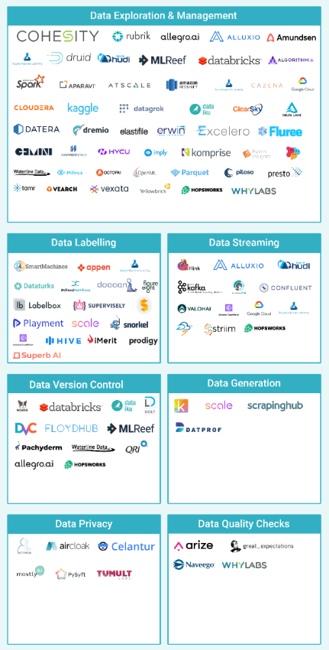
Data Management
Is this data versioning optional or mandatory? E.g., is data versioning a requirement for a system like a regulatory requirement?
What data sources are available? (e.g., owned, public, earned, paid data)
What is the storage for the above data? (e.g., data lake, DWH)
Is manual labeling required? Do we have human resources for it?
How to version data for each trained model?
What tooling is available for data pipelines/workflows?

Slide 16
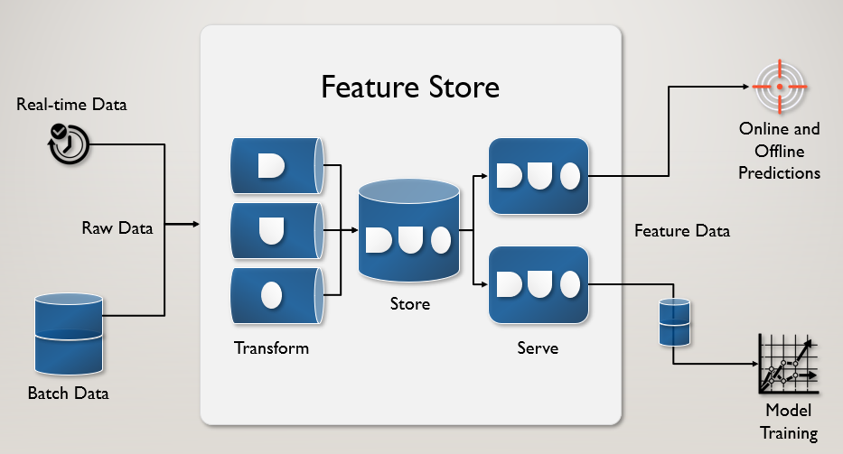

Feature Store

Slide 17




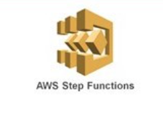

Pipeline Orchestration

Slide 18
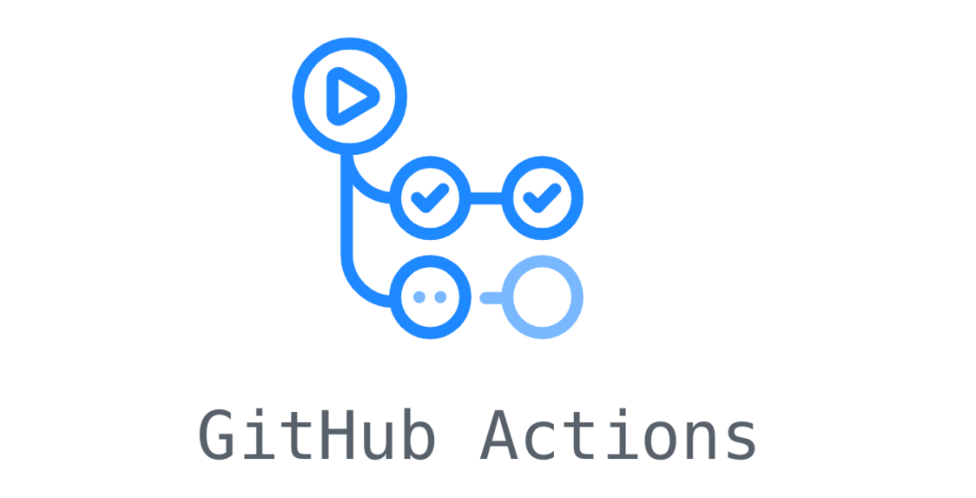



CI/CD Pipeline

Slide 19
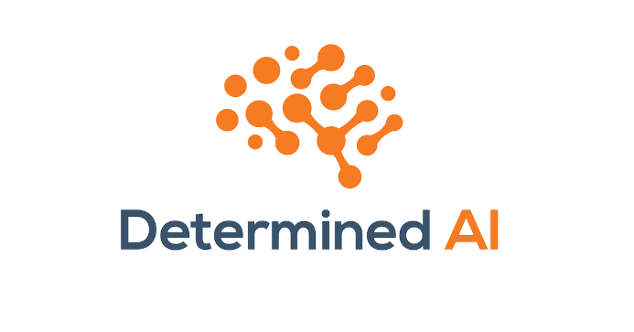
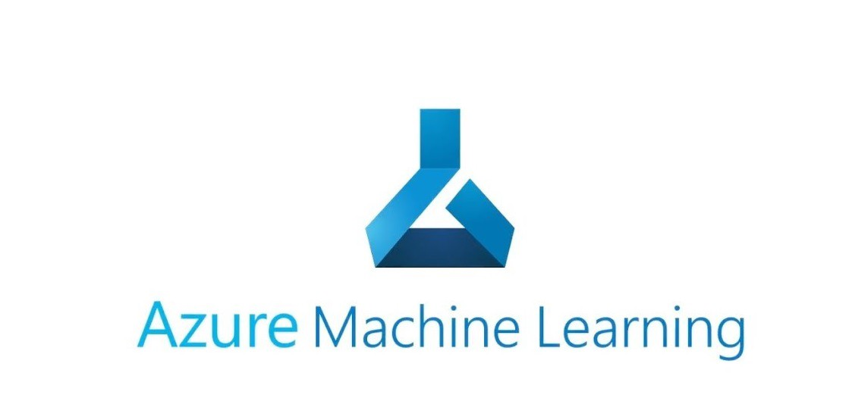

Model Registry

Slide 20
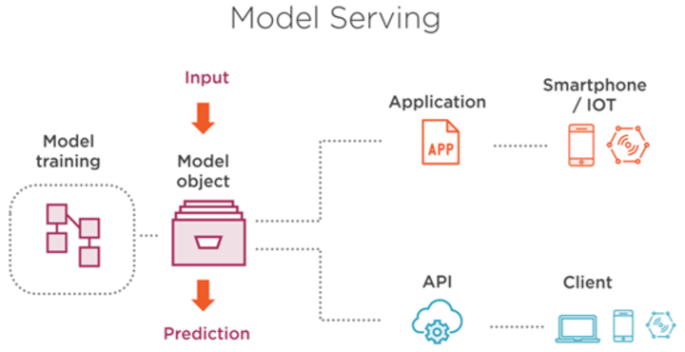
Model Serving

Slide 21
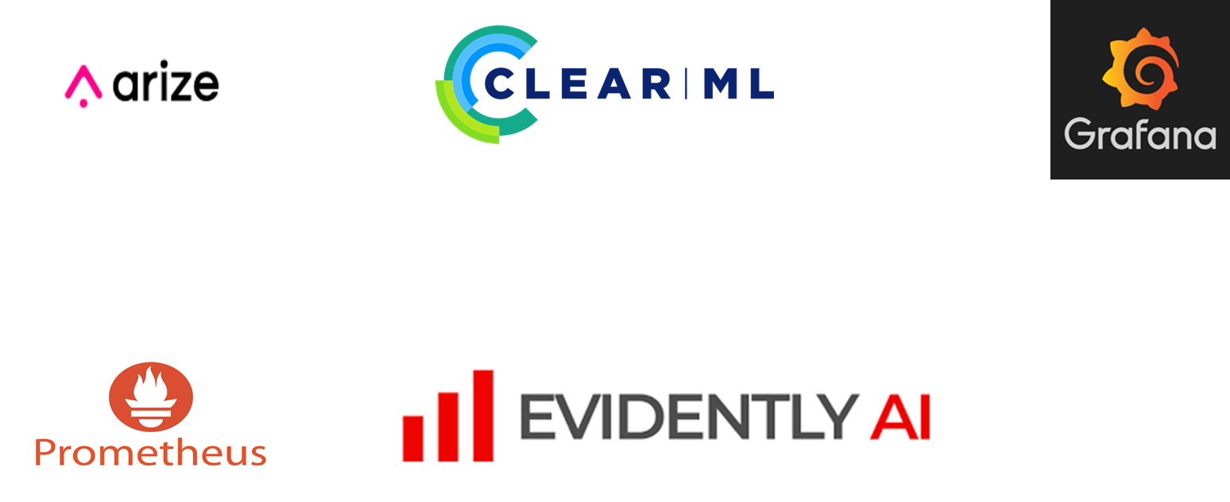
Monitoring and Alerts

Slide 22
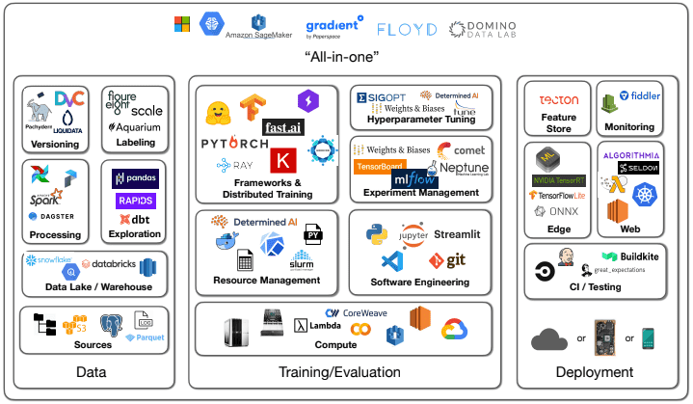
The bigger picture combining everything

Slide 23
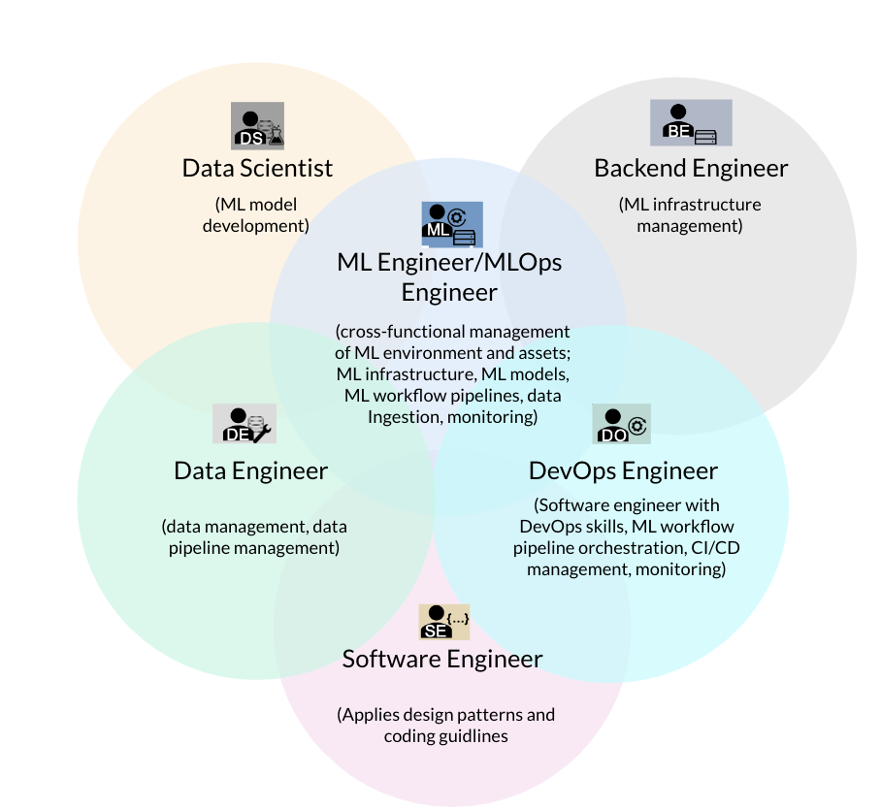
MLOps from a multi-disciplinary perspective

Slide 24
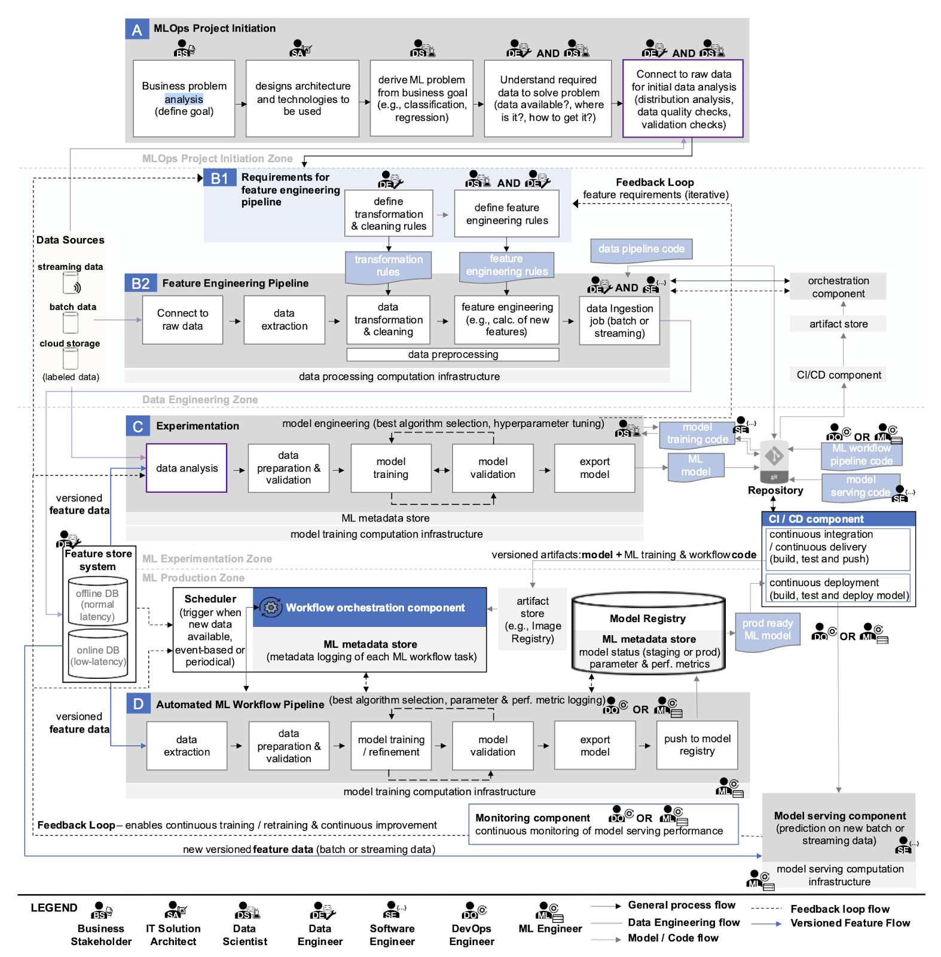

Slide 25

So, why MLOps?

Slide 26
Thank You !

